Slide 1
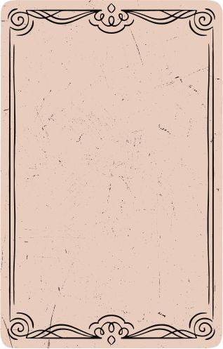


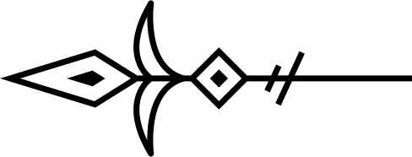
Groclake Agentathon: Next Generation Agentic Apps

Slide 2

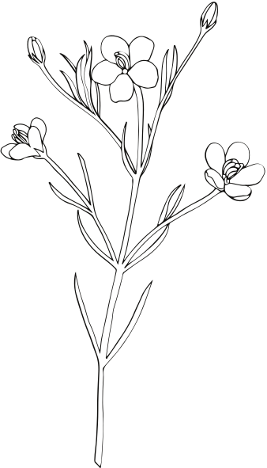
PROBLEM STATEMENT
Alzheimer’s disease affects millions worldwide, gradually erasing their most cherished memories. Patients struggle to recognize loved ones, recall personal experiences, and stay connected to their past. Traditional memory aids like photo albums and notes are passive, failing to provide the emotional engagement needed for recollection.
Current Limitations
❌ Lack of Interactivity: Traditional methods do not provide active engagement.
❌ Emotional Disconnect: Patients struggle to connect static images with memories.
❌ Fragmented Memory Support: Families find it hard to contribute to memory preservation.
❌ Cognitive Decline Progression: Without stimulation, memory loss accelerates.

Slide 3

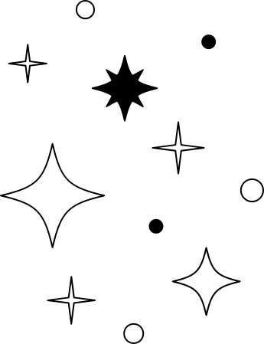
Why This Matters
Memory is more than just data—it defines identity, relationships, and emotional well-being. A better, AI-driven approach is needed to help patients actively retrieve, relive, and emotionally engage with their memories.

Slide 4


PROJECT
🧠 MemoryVault – Preserving Memories, Strengthening Bonds
🎙️ An AI-powered platform helping Alzheimer's patients reconnect with their past through natural conversations and AI-generated visuals.

Slide 5
🎗 WHY WE BUILT MEMORYVAULT?
💙 Inspired by the struggles of Alzheimer's patients
💡 A vision to go beyond static memory aids
🌟 Helping people maintain their identity & emotional bonds
“Memories fade, but connections shouldn’t.”

Slide 6
🚀 What MemoryVault Does
MemoryVault is an AI-powered memory companion designed to help Alzheimer’s patients and their families store, retrieve, and relive precious memories in an interactive and engaging way.
🌟 Key Features & Functionality
🗣️ Conversational Memory Retrieval
Patients can interact with MemoryVault and recall past experiences.
AI understands natural conversations and responds with relevant memories.
🎨 AI-Generated Visual Memories
Converts textual memories into AI-generated images to enhance recollection.
Helps patients visually connect with past moments.
Accessible UI for intuitive navigation.

Slide 7
🚀 What MemoryVault Does
📂 Secure Memory Storage
Stores personal memories in a digital vault with semantic search capabilities.
Organizes memories with tags, metadata, and family contributions.
🏡 Family Collaboration & Preservation
Family members can upload, edit, and organize memories for their loved ones.
Helps create a shared digital scrapbook for generations to come.
🔍 Smart Memory Retrieval
Uses vector embeddings & AI-powered search to find the most relevant memories.
Context-aware responses ensure personalized memory recall.

Slide 8
🛠️ HOW WE USED GROCLAKE TOOLS
MemoryVault leverages Groclake’s VectorLake & ModelLake to create an intelligent, responsive, and emotionally engaging memory companion. Here’s how:
🔹 VectorLake – Smart Memory Storage & Retrieval
✅ Converts memories into vector embeddings for fast search
✅ Stores memory chunks with metadata for contextual relevance
✅ Enables semantic similarity search for natural recall
🔹 ModelLake – Conversational AI for Memory Interaction
✅ Processes natural language queries for intuitive interactions
✅ Enhances memory recall with engaging & vivid storytelling
✅ Ensures context-aware responses to strengthen user connection

Slide 9
🔄 WORKFLOW WITH GROCKLAKE TOOLS
1️⃣ 📝 Memory Storage
Users enter memories via the UI
Text is split into chunks & vectorized
Stored efficiently using VectorLake
2️⃣ 🧠 Memory Retrieval
Users ask about a past event
Query converted into a vector for smart retrieval
Relevant memories fetched from VectorLake
ModelLake enhances the response with vivid storytelling
3️⃣ 🎨 Visual Memory Generation
AI generates stunning memory-based images
Users can experience memories both visually & verbally

Slide 10
🚀 How MemoryVault Works
User enters a memory → Provides text and optional metadata.
Memory is split into chunks → Using CharacterTextSplitter for better vector storage.
Memory is encoded → Converted into vector embeddings using VectorLake.generate().
Memory is stored in VectorLake → Saved with a unique document ID and chunk IDs.
User queries a memory → Enters a search query.
Query is encoded → Converted into vector embeddings using VectorLake.generate().
Relevant memories are retrieved → VectorLake searches and fetches the top 5 matches.
AI generates a response → ModelLake.chat_complete() creates a vivid memory recall.
Image is generated → FLUX API generates an image based on the AI response.
Response is sent to the user → AI-generated text and image are returned.

Slide 11
TECHNICAL ARCHITECTURE
🛠Frontend (React)
✅ Backend (Flask + Python)
RESTful API for storing and retrieving memories
VectorLake for memory vector embeddings and storage
ModelLake for AI-generated memory recall
FLUX API for AI-generated memory visuals
Built With...
🛠 Our Tech Stack
✅ Flask – Backend API
✅ Python – Core logic & processing
✅ VectorLake – Memory storage & retrieval
✅ ModelLake – Conversational AI for vivid responses
✅ FLUX API – AI-powered image generation
✅ React + Vercel – Frontend for user interaction

Slide 12
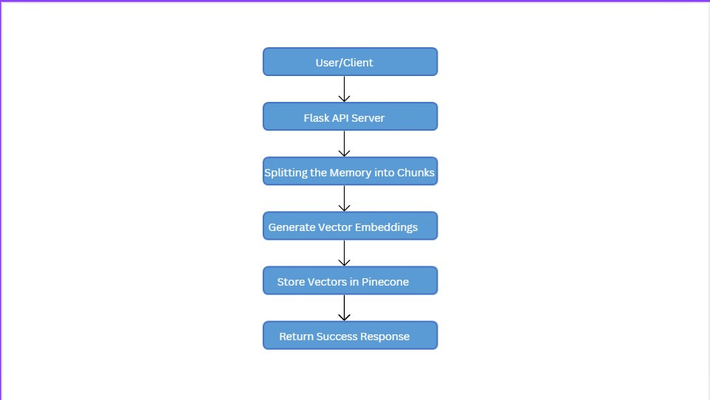
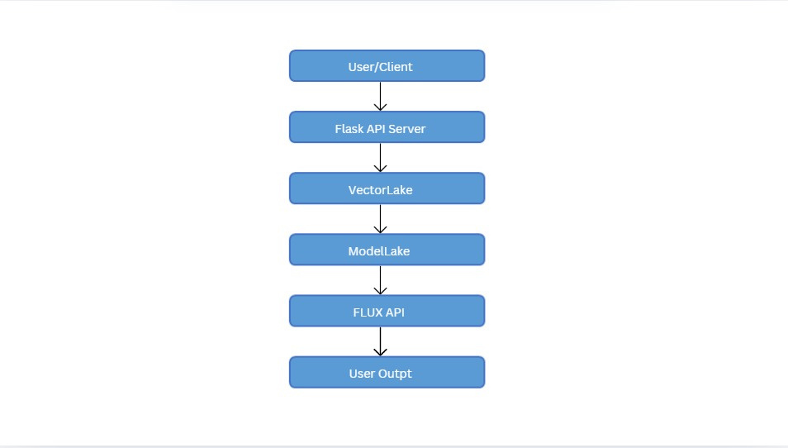
MEMORY WORKFLOW
ADD MEMORY WORKFLOW
QUERY MEMORY WORKFLOW

Slide 13
WHAT’S NEXT FOR MEMORYVAULT?
🚀 Upcoming Features & Enhancements
🎙️ Voice Interactions – Talk & listen to memories
📂 Advanced Memory Organization – Categorization & tagging
🕶️ Virtual Reality (VR) Support – Immersive memory reliving
📱 Mobile Application – On-the-go access to stored memories
🌍 Expanding to New Audiences
🏥 Partnering with healthcare providers
🎓 Collaborating with research institutions
🔒 Enhancing security & privacy features

Slide 14


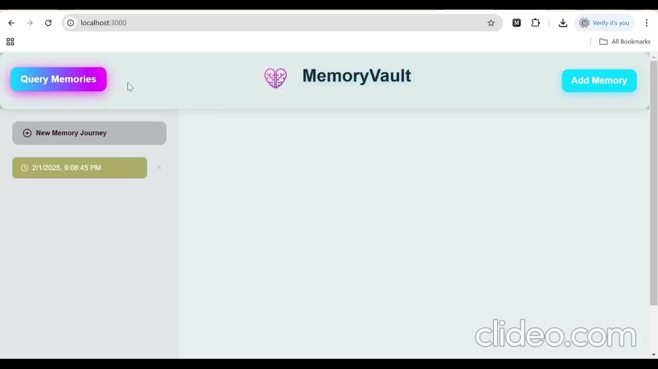

Video Demo
GitHub
https://github.com/Monishg2004/Grock_MemoryVault.git

Slide 15


Thank You

